Slide 1

Project for network programming
Chat Room
This Project Created Under Supervision : This Project Created BY :
Dr\ Muhammad A. O. Khfagy Sd\ Soliman Ali Soliman
Dr\ Ibrahim El Sayed

Slide 2
Socket programming
Sockets can be thought of as endpoints in a communication channel that is bi-directional, and establishes communication between a server and one or more clients. Here, we set up a socket on each end and allow a client to interact with other clients via the server.

Slide 3
Multi-Threading
A thread is sub process that runs a set of commands individually of any other thread. So, every time a user connects to the server, a separate thread is created for that user and communication from server to client takes place along individual threads based on socket objects created for the sake of identity of each client.

Slide 4
Server Side Script
The server side script will attempt to establish a socket and bind it to an IP address and port specified by the user (windows users might have to make an exception for the specified port number in their firewall settings, or can rather use a port that is already open). The script will then stay open and receive connection requests, and will append respective socket objects to a list to keep track of active connections. Every time a user connects, a separate thread will be created for that user. In each thread, the server awaits a message, and sends that message to other users currently on the chat. If the server encounters an error while trying to receive a message from a particular thread, it will exit that thread.

Slide 5
Client Side Script
The client side script will simply attempt to access the server socket created at the specified IP address and port. Once it connects, it will continuously check as to whether the input comes from the server or from the client, and accordingly redirects output. If the input is from the server, it displays the message on the terminal. If the input is from the user, it sends the message that the users enters to the server for it to be broadcasted to other users.

Slide 6
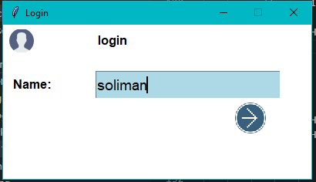
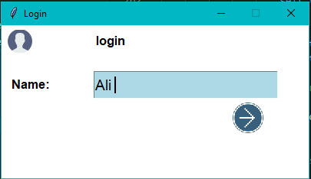
The page of chat room
Page login

Slide 7
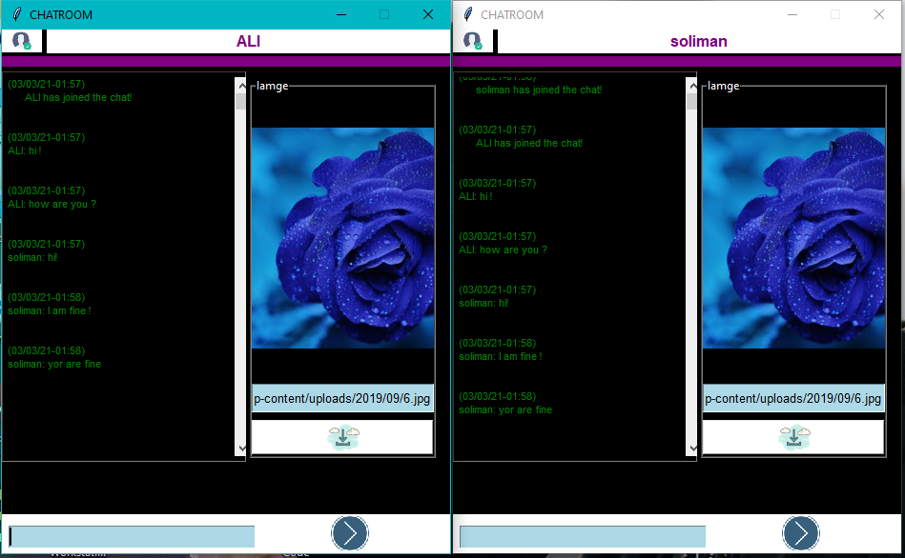
The chat room

